Slide 1
CSE101-lec#15
Recursive function

Slide 2
Outline
Recursion
Examples of recursion
  Finding factorial of a number
  Finding Fibonacci series up to nth term
Recursion Vs Iteration

Slide 3
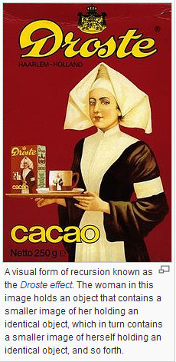
Recursion
Recursive functions
  Functions that call themselves
  Can only solve a base case
  Divide a problem into
    What it can do
    What it cannot do
      What it cannot do resembles original problem
      The function launches a new copy of itself (recursion step) to solve what it cannot do
  Eventually base case gets solved
    Gets plugged in, works its way up and solves whole problem

Slide 4



Recursion example (factorial)
Factorial of a number in mathematics
  5! = 5 * 4 * 3 * 2 * 1
Another method we have studied is
  For 5!, we write 5! = 5 * 4!
  Then for 4!, 4! = 4 * 3!
  Then for 3!, 3! = 3 * 2!
  Then for 2!, 2! = 2 * 1!
  Then for 1!, 1! = 1 * 0!
  And if its comes to 0,
  0!=1
  Solve base case (1! = 0! = 1)
120
24
6
2
1

Slide 5
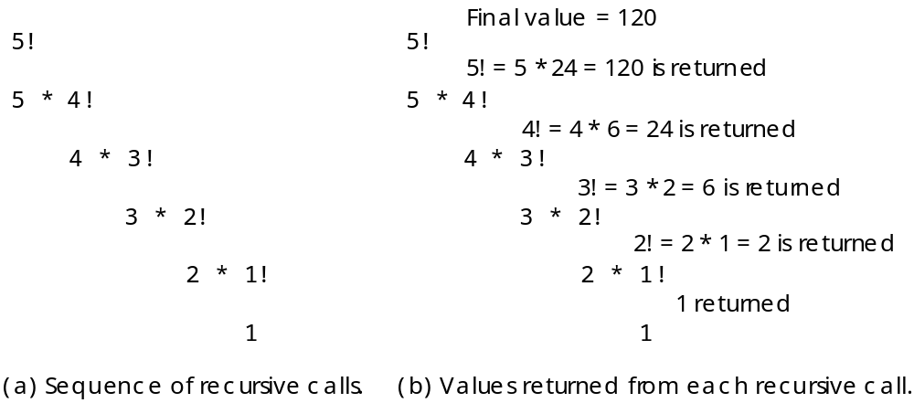
Recursion example (factorial)

Slide 6
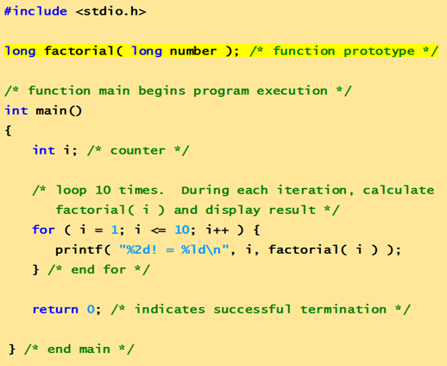

Slide 7
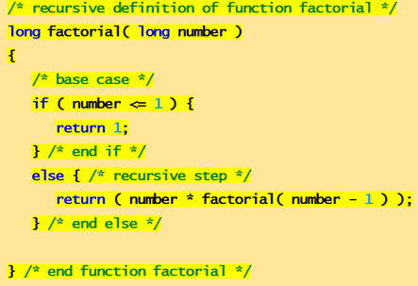

1! = 1
2! = 2
3! = 6
4! = 24
5! = 120
6! = 720
7! = 5040
8! = 40320
9! = 362880
10! = 3628800

Slide 8
Recursion example (Fibonacci)
What is Fibonacci series: …??
0, 1, 1, 2, 3, 5, 8...
  Each number is the sum of the previous two
  Can be solved recursively:
    fib( n ) = fib( n - 1 ) + fib( n – 2 )
  Code for the fibonacci function
    long fibonacci( long n )
    {
    if (n == 0 || n == 1) // base case
    return n;
    else
    return fibonacci( n - 1) + fibonacci( n – 2 );
    }

Slide 9
Recursion example (fibonacci)
Set of recursive calls to fibonacci() function
f( 3 )
return
f( 2 )
+
f( 1 )
return
f( 1 )
+
f( 0 )
return 1
return 1
return 0

Slide 10
Execution Trace (decomposition)
fibonacci(4)
fibonacci(3)
fibonacci(2)

Slide 11
Execution Trace (decomposition)
fibonacci(4)
fibonacci(3)
fibonacci(2)
fibonacci(2)
fibonacci(1)

Slide 12
Execution Trace (composition)
fibonacci(4)
+
fibonacci(3)
fibonacci(2)
+
fibonacci(2)->1
fibonacci(1)->0

Slide 13
Execution Trace (composition)
fibonacci(4)
+
fibonacci(3)->1
fibonacci(2)->1

Slide 14
/* Fibonacci Series c language using recursion */
#include<stdio.h>
int Fibonacci(int);
main()
{
int n,i;
scanf("%d",&n);
printf("Fibonacci series \n");
for ( i = 0 ; i < n ; i++ )
{
printf("%d\t", Fibonacci(i));
}
return 0;
}
int Fibonacci(int n)
{ if ( n == 0 ) return 0;
else if ( n == 1 ) return 1;
else return ( Fibonacci(n-1) + Fibonacci(n-2) );
}
5
Fibonacci series 0 1 1 2 3

Slide 15
Fibonacci code: using loops
/* Fibonacci Series c language using loop */
#include<stdio.h>
int main()
{
int n, first=0,second=1,next,i;
printf("Enter the number of terms\t"); scanf("%d",&n);
printf("First %d terms of Fibonacci series are:\t",n);
for(i=0;i<n;i++)
{
if ( i <= 1 )
next = i;
else
{next = first + second;
first = second;
second = next;}
printf("%d\n",next);
}
return 0;
}
Enter the number of terms 5
First 5 terms of Fibonacci series are:0 1 1 2 3

Slide 16
Recursion vs. Iteration
Repetition
  Iteration: explicit loop(for, while)
  Recursion: repeated function calls
Termination
  Iteration: loop condition fails
  Recursion: base case reached
Both can have infinite loops
Balance
  Choice between performance (iteration) and good software engineering (recursion)

Slide 17
Rules for recursive function
In recursion, it is essential to call a function itself
Only the user defined function can be involved in the recursion. Library function cannot be involved in recursion because their source code cannot be viewed
A recursive function can be invoked by itself or by other function.
To stop recursive function, it is necessary to base recursion on some condition, and proper termination statement such as exit() or return
The user defined function main() can be invoked recursively.

Slide 18
Next Lecture
Life time and existence of a variable …??
storage classes

